Slide 1
THIAGARAJAR COLLEGE OF ENGINEERING,MADURAI
DEPARTMENT OF ECE
22EC790 – PROJECT-III
Review-I
Real-Time Aviation Speech Dataset Acquisition for Speech Emotion Recognition
Guided By,
DR.M.N.SURESH ,
ASSOCIATE PROFESSOR,
ELECTRONICS AND COMMUNICATION ENGINEERING,
TCE.
Team Members
2302917710621091 - NISHAANTH R
2303917710621032 -HARI HARA SUDHAN C
2303917710621317- PREM KUMAR P

Slide 2
Motivation
Existing SER Datasets
RAVDESS
CREMA-D
TESS
SAVEE
Limitations
Studio recorded
Artificial emotions
No aviation terminology
No radio channel noise
Not suitable for real aviation communication

Slide 3
Objectives:
Study aviation voice communication.
Design a real-time aviation speech acquisition system.
Build an aviation speech dataset.
Apply Speech Emotion Recognition in later phases.
Main Goal:
Our first goal is to acquire real-time aviation speech and build a domain-specific dataset.
"Initially, we intended to collect cockpit speech. After studying aviation communication systems, we found that cockpit audio is not accessible. Therefore, we shifted our focus to pilot–ATC VHF radio communication, which better represents real aviation speech."

Slide 4
Why does aviation use VHF?
VHF has several advantages:
Good line-of-sight propagation
Low atmospheric noise
Reliable voice quality
Suitable for long-distance aircraft-to-ground communication
The civil aviation voice band is:
118.000 MHz – 136.975 MHz
Civil aviation uses AM (DSB-FC)

Slide 5
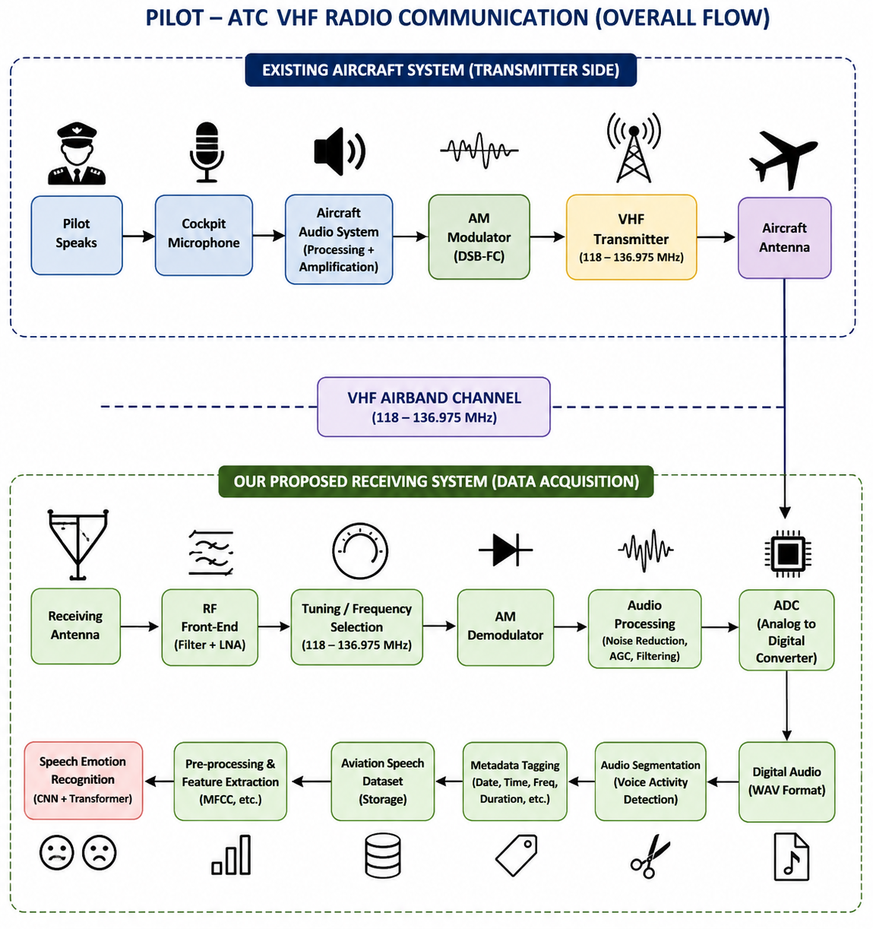
Pilot–ATC Communication Framework

Slide 6
What happens inside the aircraft?
Step 1
The microphone converts speech into an electrical signal.
Step 2
The aircraft radio processes the audio.
Step 3
The audio is Amplitude Modulated (AM) onto a VHF carrier.
Step 4
The aircraft antenna transmits the RF signal.
What happens at the ground station?
The ATC antenna receives the radio signal.
The receiver selects the desired VHF channel.
AM demodulation extracts the speech.
The controller hears the pilot

Slide 7
THANK YOU

